Slide 1
Multi-Thread TCP Server
School of Information and Communication Technology,
Hanoi University of Science and Technology

Slide 2
References
[1] W.Richard Stevens, Unix Network Programming Vol.1, 3rd Ed., Prentice Hall.
[2] Keir Davis, John W. Turner, and Nathan Yocom, The Definitive Guide to Linux Network Programming, Apress.
[3] Michael Donahoo, Kenneth Calvert, TCP/IP Sockets in C: Practical Guide for Programmers, Elsevier.

Slide 3
Content
Multi-thread Programming
Threads Synchronization
Multi-thread TCP Server

Slide 4
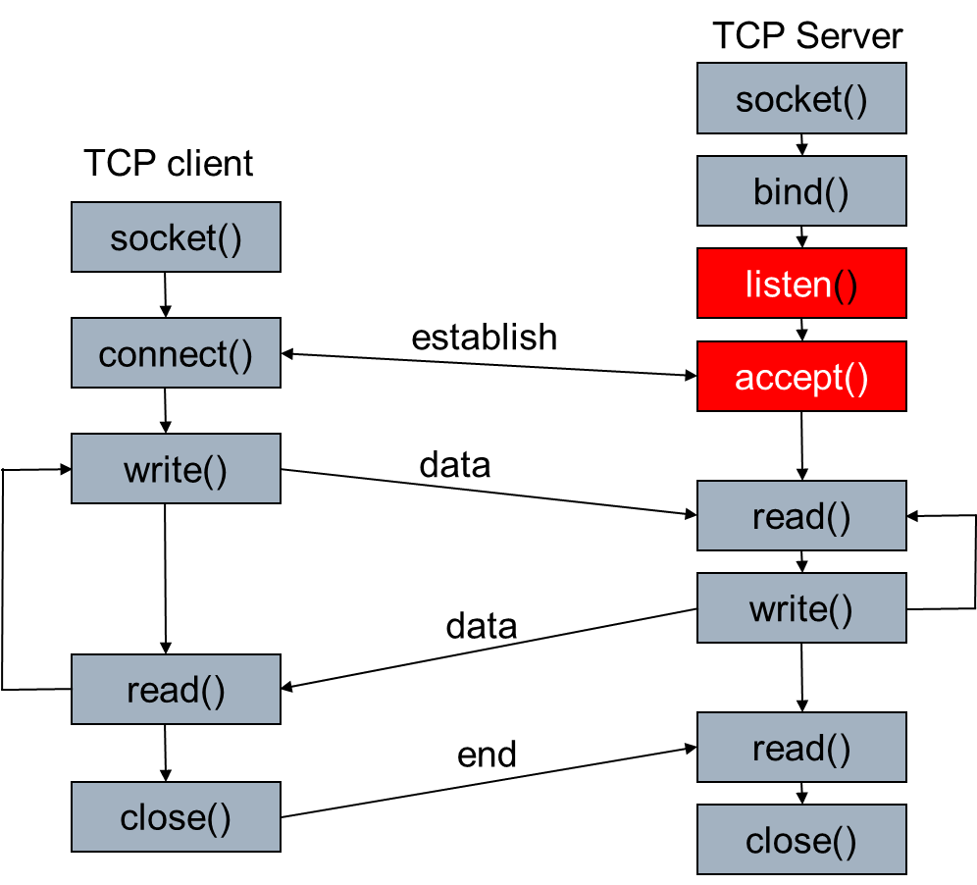
Single-client Server

Slide 5
Fork and Thread
fork is expensive. Memory is copied from the parent to the child, all descriptors are duplicated in the child, and so on.
Threads are sometimes called lightweight processes since a thread is "lighter weight" than a process. That is, thread creation can be 10–100 times faster than process creation.
All threads within a process share the same global memory, but along with this simplicity comes the problem of synchronization

Slide 6
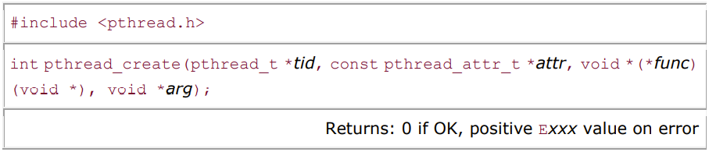
pthread_create
Each thread has numerous attributes: its priority, its initial stack size, and so on. We can specify these attributes by initializing a pthread_attr_t or use the default configuration by setting attr to NULL
func is a fuction pointer which points to the address of the thread’s code
arg is the argument of the function, multiple parameters need to be packaged into one structure.

Slide 7
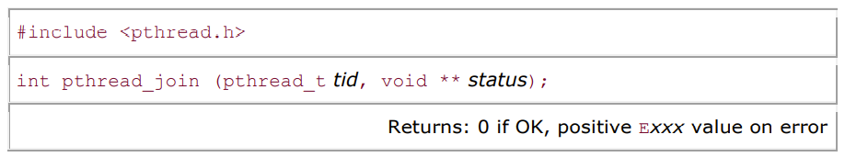
pthread_join
We can wait for a given thread to terminate by calling pthread_join. Comparing threads to Unix processes, pthread_create is similar to fork, and pthread_join is similar to waitpid.

Slide 8
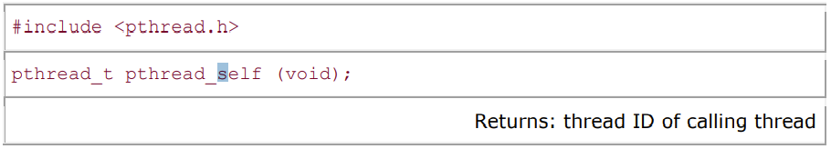
pthread_self
A thread fetches its id using pthread_self.

Slide 9
Exercise
White a multi-thread program to compute sum of integers from 1 to K
Input the number of threads (N < K)
Create N threads
Devide the range [1, K] into N segments equally
Thread i compute the sum of segment i and add the result to the final sum
Print out the final sum

Slide 10
Thread Synchronization
Multiple threads may access a same resource at a time creating a so-called conflict
Conflicts may lead to wrong result as can be seen in the above example
Thead synchronization tries to deal with those conflicts

Slide 11
Two ways of initializing a mutex
Statistically: If a mutex variable is statically allocated, we must initialize it to the constant PTHREAD_MUTEX_INITIALIZER.
pthread_mutex_t sample_mutex = PTHREAD_MUTEX_INITIALIZER;
If we allocate a mutex dynamically, we must initialize it at runtime by calling the pthread_mutex_init function
pthread_mutex_t *mptr;
mptr = (pthread_mutex_t*)calloc(…)
pthread_mutex_init(mptr, NULL)

Slide 12
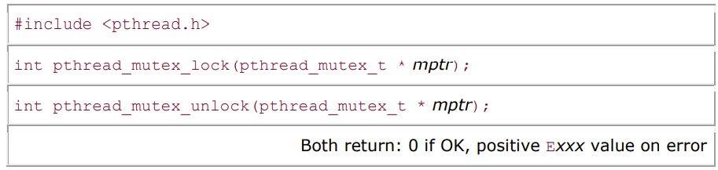
Mutex lock and unlock
The solution is to protect the shared variable with a mutex (which stands for "mutual exclusion") and access the variable only when we hold the mutex.
lock – request the access to a critical session (of code)
unlock – release the access to a critical session so that another waiting request can be granted

Slide 13
Destroy a mutex
Remember to call pthread_mutex_destroy to release the resource associated with a created mutex when it is no longer in use.

Slide 14
Exercise
Write a “chat room” server using multi-thread programming

Slide 15
Rewrite the telnet example
Rewrite our telnet example to make it able to support multiple connections
If we use the same output file for all the connections, remember to use mutex to avoid writing conflicts.

Slide 16
Excercise
Write a http file server using multi-thread programming
Able to work with web browser to explore the folder on the server
Able to received uploaded files from the web browser
Able to deliver downloaded files to the web browser

Slide 17
HTTP FILE SERVER
GET
Tạo nội dung HTML của thư mục hiện tại và trả về cho client
Lấy nội dung file mà user click vào trả về để client có thể download/play
POST
Nhận file được upload lên server từ client

Slide 18
Q&A

